Slide 1


Monthly
Market
Report
August 2025
Presented by David Childers, President of Keeping Current Matters

Slide 2

Tale of Two Markets

Slide 3
Since the national Pandemic Housing Boom fizzled out in 2022, the national power dynamic has slowly been shifting from sellers to buyers. Of course, across the country that shift has varied significantly.
Lance Lambert
Cofounder, ResiClub
Notes:
https://www.resiclubanalytics.com/p/housing-market-continues-to-become-more-buyer-friendly-inventory-state-update-june-2025

Slide 4
Buyer and Seller Dynamics Have Shifted
Estimated Number of Buyers and Sellers Active in the Market
Source: Redfin
Notes:
https://www.redfin.com/news/data-center/

Slide 5
The South and West continue to see the greatest inventory gains and the sharpest market slowdowns, with longer time on market, and more frequent price cuts.
The Northeast and Midwest remain relatively tighter by comparison but are also gradually moving toward more buyer-friendly conditions than in recent years.
Realtor.com
Notes:
https://www.realtor.com/research/july-2025-data/

Slide 6
Where Housing Inventory Is Growing the Fastest
Compared to Pre-Pandemic Norms, Inventory in the West and South Has Effectively Recovered
Source: Realtor.com
Notes:
https://www.realtor.com/research/july-2025-data/

Slide 7
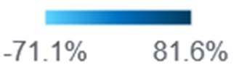
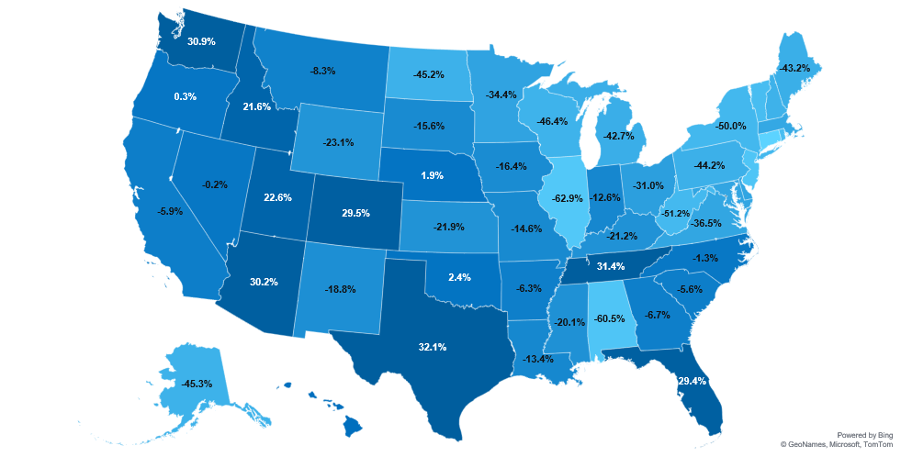
Inventory Change Compared to Pre-Pandemic
Shift Between July 2019 and July 2025
WA
MT
ND
NH -45.8%
ME
OR
MN
VT -54.3%
ID
SD
WI
NY
MA -37.8%
WY
MI
RI -54.1%
NE
IA
PA
CT -71.1%
NV
UT
IN
OH
NJ -60.5%
CA
IL
DE -35.5%
CO
KS
VA
MD -36.0%
MO
KY
WV
DC 81.6%
AZ
OK
TN
NC
NM
AR
SC
MS
AL
GA
TX
LA
AK
FL
Nationally, we’re still below pre-pandemic 2019 inventory levels
(-13.4% below July 2019).
HI
6.6%
Source: Realtor.com
Notes:
https://www.realtor.com/research/july-2025-data/

Slide 8
At the metro level, 13 of the top 50 metros now exceed their pre-pandemic inventories by 25% or more – all in the South or West regions.
On the flip side, 17 of the top 50 metros still lag at least 25% below their pre-pandemic inventory norms.
Realtor.com
Notes:
https://www.realtor.com/research/july-2025-data/

Slide 9
Local Markets Where Buyers and Sellers Have the Most Power
Rank | Sellers Have the Most Power
1 | Rochester, NY
2 | Batavia, NY
3 | New Philadelphia, OH
4 | Alma, MI
5 | Fairbanks, AK
6 | Syracuse, NY
7 | Buffalo, NY
8 | Minot, ND
9 | Fremont, OH
10 | Sterling, IL
Rank | Buyers Have the Most Power
1 | Clewiston, FL
2 | Okeechobee, FL
3 | Shelby, NC
4 | Decatur, IN
5 | Atmore, AL
6 | Forest City, NC
7 | Americus, GA
8 | Arcadia, FL
9 | Gainesville, FL
10 | Sault Ste. Marie, MI
Source: Zillow
Notes:
https://www.zillow.com/research/data/

Slide 10
Home Price Trends Vary by Area
Year-over-Year Change in Home Prices in 50 Largest Metros, June 2024 – June 2025
Source: ResiClub
Notes:
https://www.resiclubanalytics.com/p/monthly-housing-market-home-price-analysis-spanning-over-800-metros-and-3-000-counties-1d21

Slide 11

Recent Rate Stability
Benefits Buyers and Sellers

Slide 12
Mortgage rates have moved within a narrow range
for the past few months . . . Rate stability, improving inventory and slower house price growth are an encouraging combination . . .
Sam Khater
Chief Economist, Freddie Mac
Notes:
https://freddiemac.gcs-web.com/news-releases/news-release-details/mortgage-rates-remain-essentially-flat

Slide 13
Mortgage Rates Are Experiencing Less Volatility
30-Year Fixed Mortgage Rate
Source: Freddie Mac
Notes:
https://www.freddiemac.com/pmms

Slide 14
Analysts, economists and mortgage professionals are coining this quarter’s activity as one of the most “calm” periods for mortgage rates in recent memory.
HousingWire
Notes:
https://www.housingwire.com/articles/stable-mortgage-rates-loan-officers-homebuyers-reshape-conversations/

Slide 15
Borrowers should find comfort in the stability of mortgage rates, which have only fluctuated within a narrow 15-basis point range since mid-April. Although recent data show that home sales remain low, the resulting available inventory provides homebuyers with a wider range of options to consider when entering the market.
Sam Khater
Chief Economist, Freddie Mac
Notes:
https://freddiemac.gcs-web.com/node/30516/pdf

Slide 16
Buyer Demand Is Up Slightly This Year
Mortgage Purchase Application Index
Source: MBA
Notes:
https://www.mba.org/news-and-research/newsroom/news/2025/07/30/mortgage-applications-decrease-in-latest-mba-weekly-survey
https://www.mba.org/news-and-research/research-and-economics/single-family-research/weekly-applications-survey

Slide 17
I expect a generally downward trend for rates this year,
but at a slow enough pace that it might not be noticeable in any given month.
Danielle Hale
Chief Economist, Realtor.com
Notes:
https://themortgagereports.com/32667/mortgage-rates-forecast-fha-va-usda-conventional

Slide 18
Mortgage Rates & Projections
30-Year Fixed Rate, As of 7/31/2025
Sources: Fannie Mae, MBA, Wells Fargo
Notes:
https://www.fanniemae.com/media/55996/display
https://img03.en25.com/Web/MortgageBankersAssociation/%7B76e5d77f-5cae-41d3-8cdc-ab508f86a6bc%7D_Mortgage_Finance_Forecast_June_2025.pdf
https://wellsfargo.bluematrix.com/links2/html/ad572bb7-25c3-4135-a3f8-b1d925e7bdb8#bm-img-23423856-1ff6-4cc7-bcee-d6806e299cd8

Slide 19
Even incremental, small changes [in mortgage rates],
I think, will bring more buyers.
Lawrence Yun
Chief Economist, NAR
Notes:
https://www.nar.realtor/magazine/real-estate-news/home-buyer-demand-shows-signs-of-strengthening

Slide 20
Slightly lower mortgage rates toward the end of the year could further improve affordability, but significant improvements appear unlikely.
Kara Ng
Senior Economist, Zillow Home Loans
Notes:
https://www.mpamag.com/us/mortgage-industry/market-updates/mortgage-rates-slip-for-fourth-straight-week/540769

Slide 21
Even a Small Change in Rates Can Help
Reduce Payments
Home Loan Amount | Fixed Mortgage Rate | Monthly Mortgage P&I* | Savings
$400,000 | 7.00% | $2,661.21 | –
$400,000 | 6.75% | $2,594.39 | $66.82
$400,000 | 6.50% | $2,528.27 | $132.94
*Principal and Interest Payment
Total monthly payment may vary based on loan specifications such as property taxes, insurance, HOA dues, and other fees. Consult your licensed mortgage advisor for current rates.
Source: MortgageCalculator.net
Notes:
https://www.mortgagecalculator.net/

Slide 22
Trying to time mortgage rates is really difficult. There’s no guarantee that rates are going to be any more favorable in three months or six months.
Jeff Ostrowski
Housing Market Analyst, Bankrate
Notes:
https://www.bankrate.com/real-estate/when-will-mortgage-rates-drop/#when-will-mortgage-rates-drop

Slide 23
For potential home buyers, it’s important to get quotes from multiple lenders for a mortgage, as rates can vary dramatically . . .
Odeta Kushi
VP and Deputy Chief Economist, First American
Notes:
https://themortgagereports.com/32667/mortgage-rates-forecast-fha-va-usda-conventional

